Slide 1
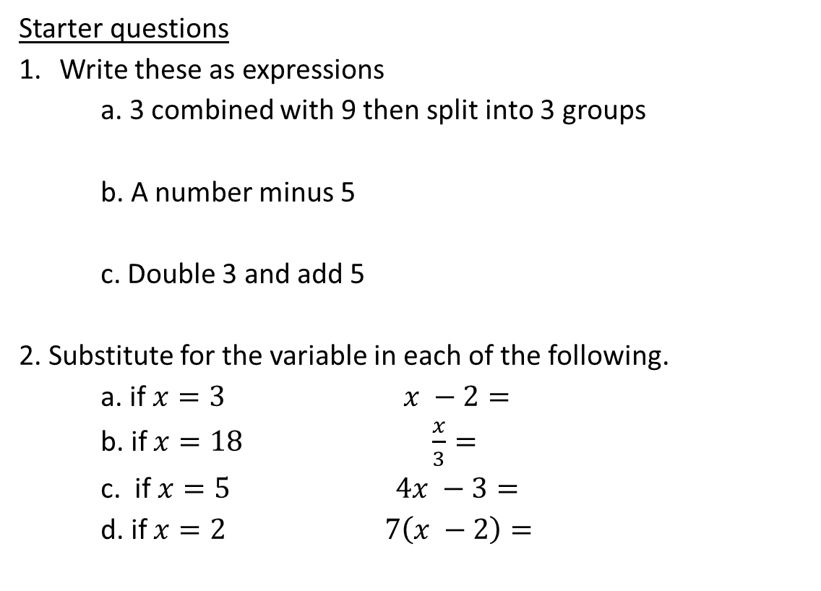
Starter questions
Write these as expressions
a. 3 combined with 9 then split into 3 groups
b. A number minus 5
c. Double 3 and add 5
2. Substitute for the variable in each of the following.
a. if $x=3 x −2=$
b. if $x=18 \frac{x}{3}=$
c. if $x=5 4x −3=$
d. if $x=2 7\left(x −2\right)=$

Slide 2
Topic : Worded Questions
24
7
30
Date
EQ : How do we answer worded Questions?
C - Circle the numbers in the question
U - Underline the question
B - Box the keywords
E - Eliminate the unnecessary information
S - Solve the question with working out
What is C.U.B.E.S?
Example
Jane spent $42 for shoes she also bought a new hat, sunglasses and a new shirt. This was $14 less than she spent for the new shirt. How much was the shirt?
42 = shirt - 14
42 + 14 = shirt
56 = shirt The shirt cost $56

Slide 3
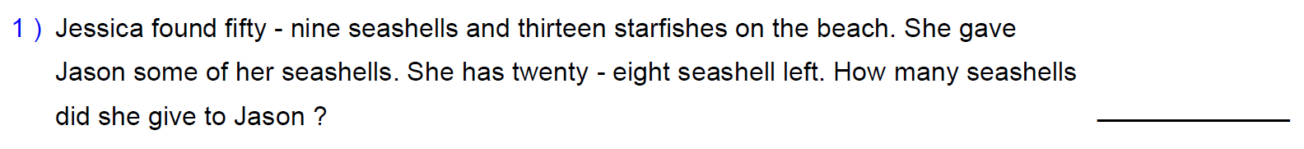
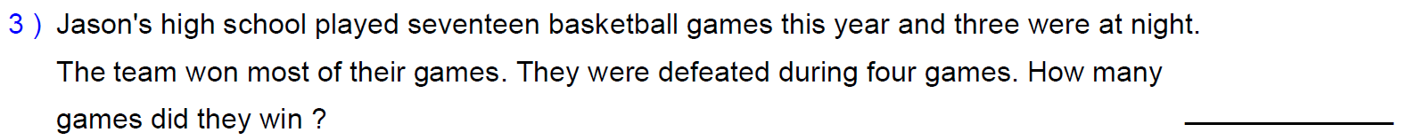

Slide 4
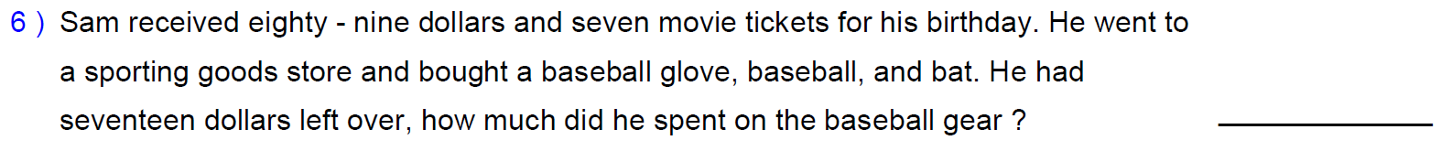

Slide 5
